Slide 1

Bipartite Graph
NAME – GURUPRASAD DALWADI
ENROLLMENT NO – 12202040601017
BATCH – A4
SUBJECT – DESIGN AND ANALYSIS OF ALGORITHM
DEPARTMENT – COMPUTER ENGINEERING

Slide 2
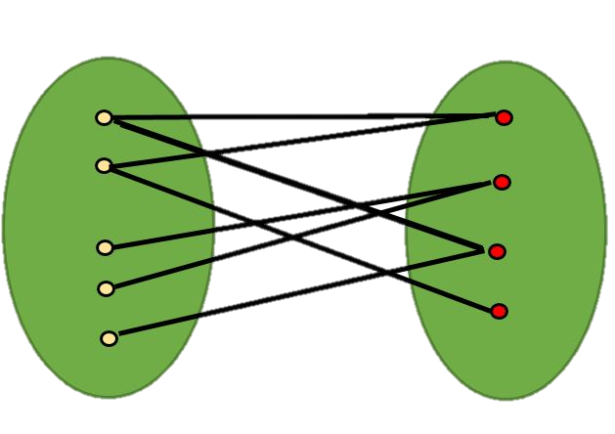
What is a Bipartite Graph?
Two Distinct Node Sets
No Edges Within Sets
A bipartite graph consists of two disjoint sets of nodes, with edges only connecting nodes from different sets.
There are no edges between nodes within the same set, ensuring the graph is divided into two partitions.

Slide 3

Properties of Bipartite Graphs
Planar
Acyclic
2-Colorable
Bipartite graphs can be drawn in a plane without any edges crossing, making them inherently planar structures.
Bipartite graphs do not contain any cycles of odd length, as they consist of two disjoint sets of nodes.
The nodes of a bipartite graph can be colored using only two colors, with no adjacent nodes sharing the same color.

Slide 4
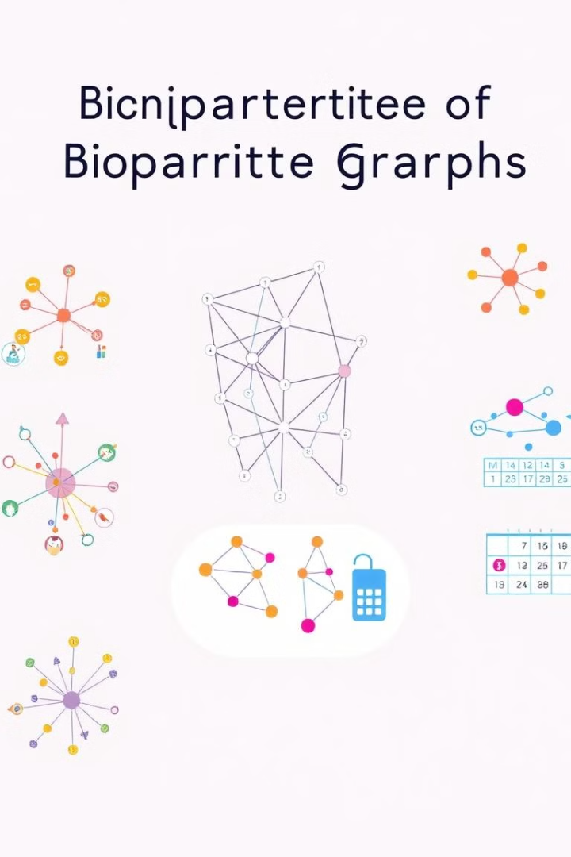
Applications of Bipartite Graphs
Social Networks
Recommendation Systems
Bipartite graphs can model relationships between users and the content they interact with, such as posts, groups, or pages.
Bipartite graphs are used to represent the relationship between users and items, enabling personalized recommendations.
Scheduling
Matching Problems
Bipartite graphs can model the assignment of tasks to resources, helping in optimization and scheduling problems.
Bipartite graphs are well-suited for solving matching problems, such as in job-hiring, organ transplantation, or dating platforms.

Slide 5
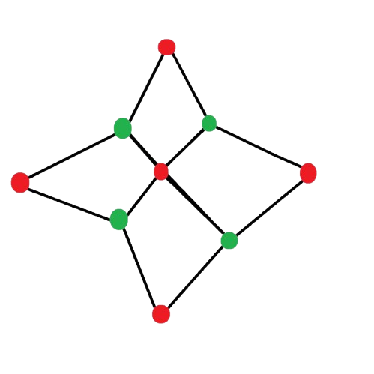

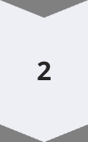
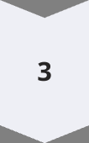


Implementation in Pseudocode
Initialize Colors
Create a dictionary to store the colors of each node.
Traverse Graph
Iterate through each unvisited node and perform a depth-first search (DFS).
Assign Colors
During the DFS, assign the opposite color to each neighboring node.
Check for Conflicts
If a node is assigned the same color as its neighbor, the graph is not bipartite.
Return Result
If the entire graph is successfully colored, it is a bipartite graph.

Slide 6


Pseudo-code for Bipartite Graph Checking
function isBipartite(graph): color = {} for node in graph: if node not in color: if not dfs(graph, node, 0, color): return False return TrueC function dfs(graph, node, c, color): color[node] = c for neighbor in graph[node]: if neighbor not in color: if not dfs(graph, neighbor, c ^ 1, color): return False elif color[neighbor] == c: return False return True

Slide 7
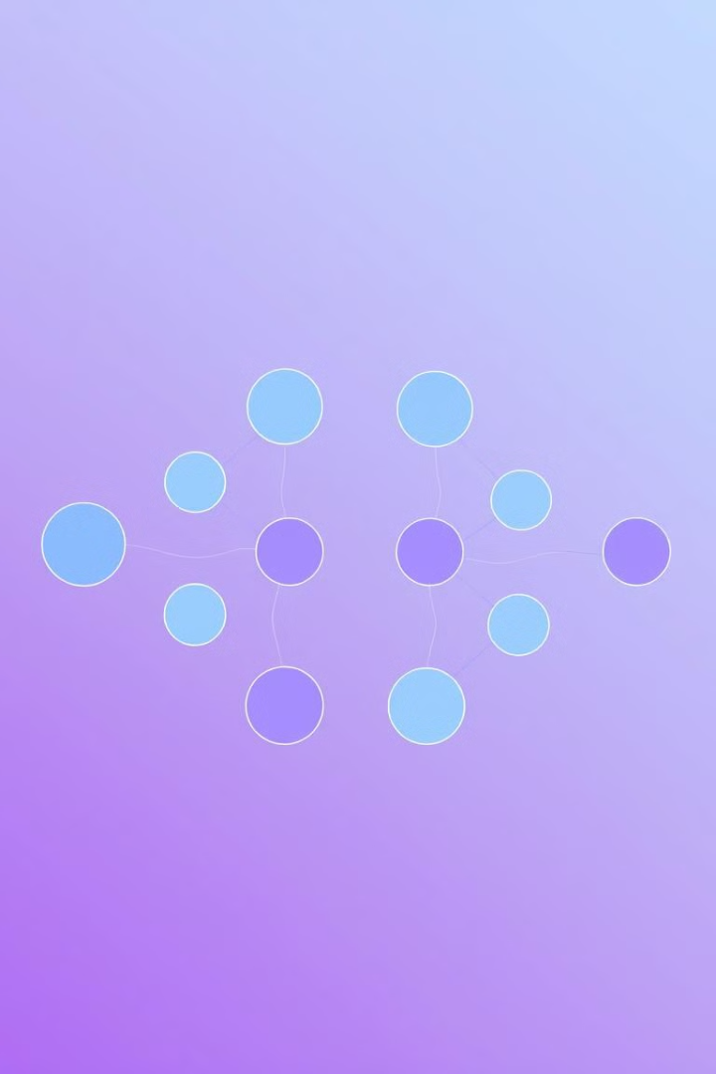
Time Complexity Analysis
1
Vertex Traversal
2
Edge Traversal
The algorithm visits each vertex in the graph once, which takes O(V) time.
For each vertex, the algorithm explores all its adjacent edges, taking O(E) time.
3
Overall Complexity
The overall time complexity of the bipartite graph checking algorithm is O(V + E), which is linear in the size of the graph.

Slide 8





Implementation Considerations
Graph Representation
Optimization Potential
Bipartite graphs can be efficiently represented using adjacency lists or matrices.
The unique properties of bipartite graphs can be leveraged to optimize algorithms and improve performance.
Scalability
Real-World Applications
The linear-time algorithm for checking bipartiteness makes it suitable for large-scale graph processing.
Bipartite graphs have numerous practical applications in fields like social networks, recommendation systems, and scheduling.

Slide 9

Thank you 😊
12202040601017

